Slide 1
Graduate Teaching Assistant Workshop Spring, 2026 Dr. Merilee A. Krueger Psychological Science
Notes:
This template can be used as a starter file for presenting training materials in a group setting.
Sections
Right-click on a slide to add sections. Sections can help to organize your slides or facilitate collaboration between multiple authors.
Notes
Use the Notes section for delivery notes or to provide additional details for the audience. View these notes in Presentation View during your presentation.
Keep in mind the font size (important for accessibility, visibility, videotaping, and online production)
Coordinated colors
Pay particular attention to the graphs, charts, and text boxes.
Consider that attendees will print in black and white or grayscale. Run a test print to make sure your colors work when printed in pure black and white and grayscale.
Graphics, tables, and graphs
Keep it simple: If possible, use consistent, non-distracting styles and colors.
Label all graphs and tables.

Slide 2

GTA Workshop
Congratulations!!

Slide 3


GTA Workshop
New position
New duties
New responsibilities

Slide 4
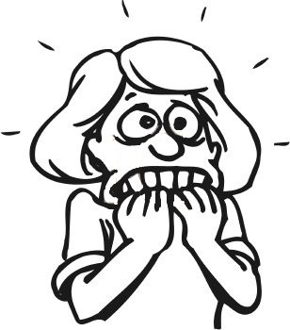
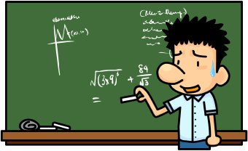
GTA Workshop
Being Nervous - OK! –
Resources to help!

Slide 5


GTA Workshop
Various rules/regulations
FERPA
Sexual Harassment
Title IX

Slide 6
GTA Workshop
Policies/Procedures to Know:
Family Educational Rights and Privacy Act
(FERPA)

Slide 7

GTA Workshop
Purpose?
Privacy of student records – defines who has right of access to records
Prohibits disclosing educational records/ personally identifiable information from student's records without student's consent.

Slide 8

GTA Workshop
What are "education records"?
Records, files, documents, other materials- information directly related to student/ maintained by university in various forms - paper/electronic.

Slide 9

GTA Workshop
Specific Examples -
Grades
Assignments
Class Lists
Student Course Schedules
Disciplinary Records
Attendance
Student Financial Records …

Slide 10
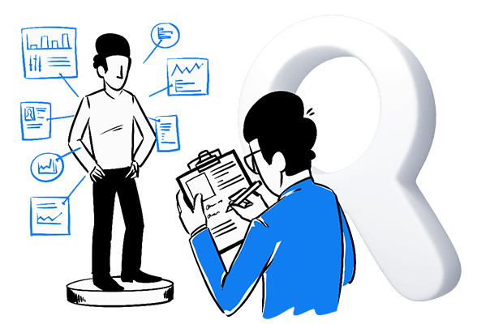
GTA Workshop
What is “personally identifiable information”?
Could reveal identity/personal information of students - could allow someone track down identity of student.

Slide 11
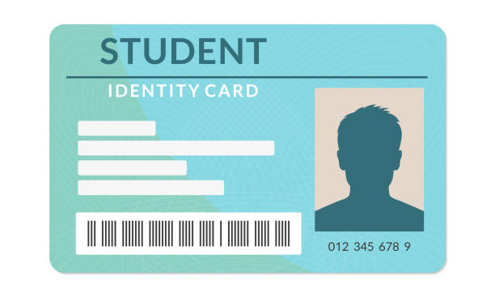
GTA Workshop
Specific Examples:
Social security number (SSN)
Student ID
Street Address
Telephone numbers
E-mail address

Slide 12

GTA Workshop
What Does this Mean for GTA?
Protect Privacy of Students
Do Not Discuss Students *
Do Not E-mail Grades
Others…

Slide 13

GTA Workshop
When in Doubt – Ask! Much Easier to Go Back Than “Un”-Do an Action.

Slide 14
GTA Workshop
Another important law -
Title IX - protects people from discrimination or violence based on sex in education programs/activities receive federal financial assistance.

Slide 15

GTA Workshop
Specific Policy - https://www.umsystem.edu/ums/rules/collected_rules/equal_employment_educational_opportunity/ch600/600.020-sexual-harassment-under-title-ix-matters-involving-conduct
600.020 Sexual Harassment under Title IX – (matters alleged on or after August 14, 2020)
…”University intends that sexual harassment in the work place or educational environment is unacceptable conduct…”

Slide 16

GTA Workshop
Relationships with Students:
Be Friendly, but Maintain Boundaries
Show You Care – Do Not Cross Line
Be Respectful
Be Aware of Cultural Differences

Slide 17
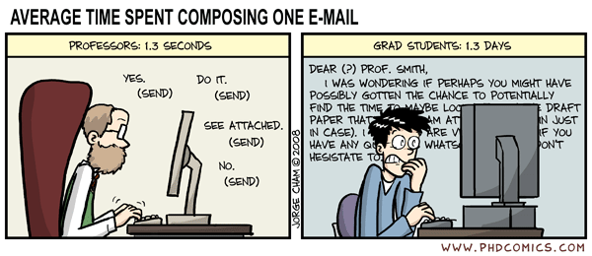
GTA Workshop
Social Media – Check Policies
Communication ~ e-mail best (not grades ☺)
After Hours ?
When in Doubt – ASK!

Slide 18
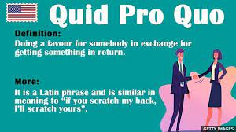
GTA Workshop
“Quid Pro Quo” - employee of University conditioning provision of - aid, benefit, service of University on individual’s participation in unwelcome sexual conduct

Slide 19
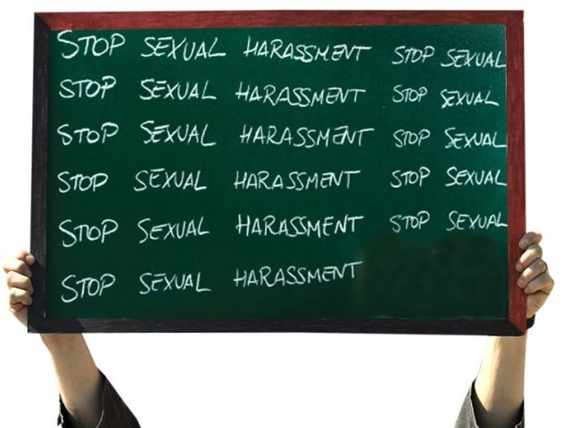
GTA Workshop
Hostile Environment Sexual Harassment –”Unwelcome conduct determined by reasonable person to be so severe, pervasive, objectively offensive - effectively denies person equal access to University’s education program/activity…

Slide 20
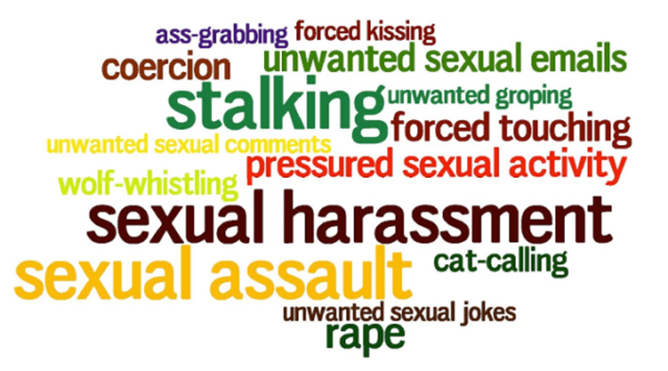
GTA Workshop
What Does This Mean for You?
Be Aware
Inform Yourself
Understand Cultural Differences
Intent = Irrelevant

Slide 21


GTA Workshop
Your Position Creates - Imbalance of Power
Psychologists Propose - Consent Not Possible in this Relationship

Slide 22
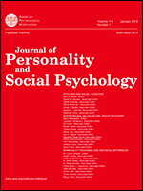
GTA Workshop
Research – Williams, Gruenfeld, Guillory (2017) in Journal of Personality and Social Psychology “Sexual aggression when power is new: Effects of acute high power on chronically low-power individuals”

Slide 23

GTA Workshop
Practical Suggestions:
Do NOT initiate any type of romantic or sexual relationship with students
Do NOT suggest – even as joke - requirements lessened or grade changed if spend time socially/romantically with you

Slide 24
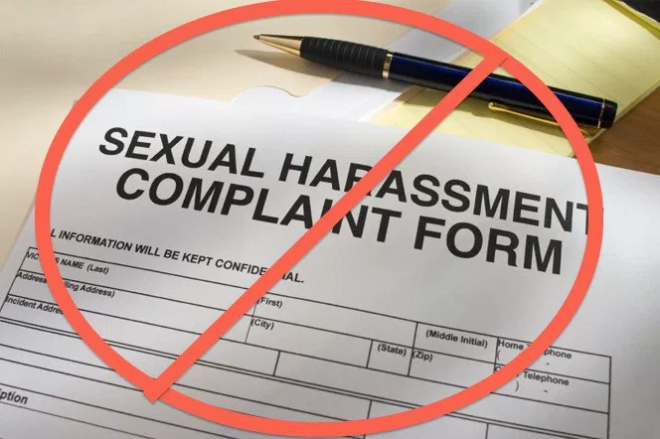
GTA Workshop
Do NOT make remarks about students’ clothing, body, activities that could be interpreted as sexual. Even if consider to be in appreciation.
Do NOT say as put-down
Do NOT use terms of endearment

Slide 25

GTA Workshop
Do NOT make insulting sounds – (suggestive whistling…)
Do NOT make intimidating, angry, loud, or insulting language where someone feels frightened (this is verbal violence)

Slide 26

GTA Workshop
Do NOT make any jokes about sex or gender
Do NOT touch students inappropriately (attempted kissing, fondling, or assault)
Do NOT make obscene gestures or expose your body to students

Slide 27

GTA Workshop
Do NOT display sexually explicit or sexually derogatory cartoons, photos, drawings, calendars, posters, T-shirts.
Do NOT say, joke or imply women (any group) cannot learn material/run an instrument as quickly or as well as men (others).

Slide 28

GTA Workshop
Various laws also exist to guard students members of certain groups:
Protected Classes - groups with common characteristic legally protected from discrimination on basis of that characteristic

Slide 29


GTA Workshop
Some examples:
Race
Color
Religion
National Origin
Age (40 and over) …

Slide 30
GTA Workshop
Conclusion –
Be Informed
Know Policies
Take Care of Yourself
Ask Questions

Slide 31

GTA Workshop
Questions…?
My e-mail Krueger@mst.edu

